Slide 1
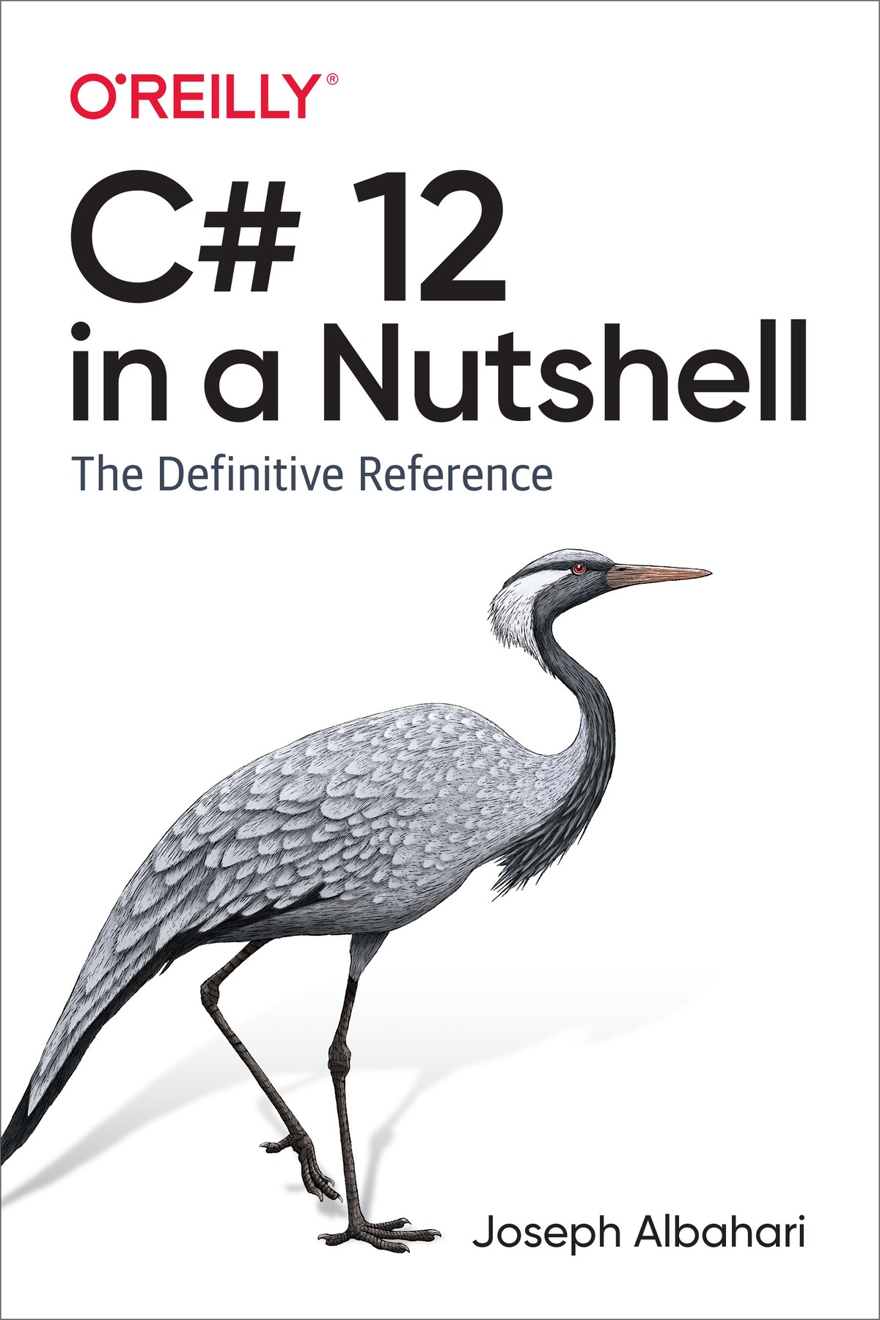
Chapter 7 - Arrays

Slide 2
Construction and Indexing

